Slide 1


Enhancing our
3D-abilities;
lessons learned
from the EuroSDR
3D Spatial Interest Group
Martin Salzmann, president EuroSDR
PCC Conference, Riga, May 11-13 2015
Notes:
Checken!
UK Dame – Sally Cooper?
Doorsturen Auditr Report 2013!
Report of the Secretariat
Minutes Copenhagen
Newsletter October

Slide 2
About EuroSDR
EuroSDR is
a not-for-profit organisation
linking National Mapping and Cadastral Agencies with
Research Institutes and Universities in Europe
for the purpose of applied research in
spatial data provision, management and delivery.
20 member countries
Work is done in working groups and commissions
Notes:
Programma doorlopen

Slide 3
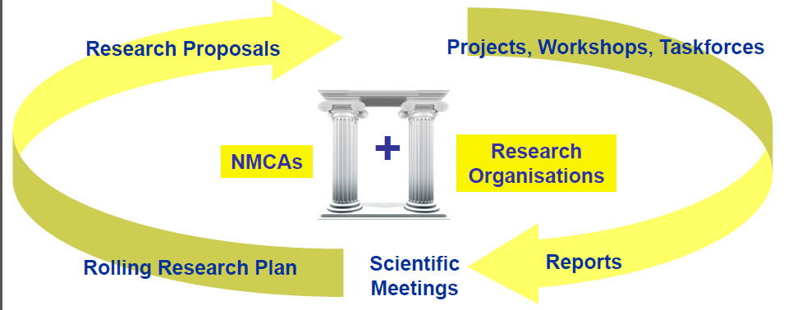
Outreach
Courses

Slide 4
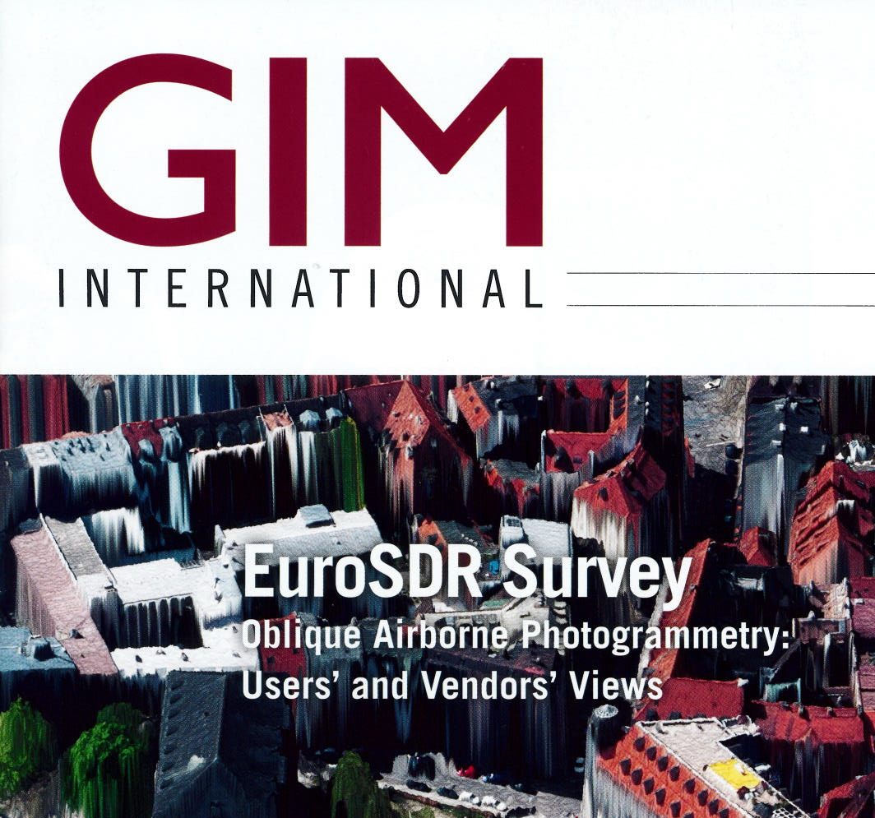
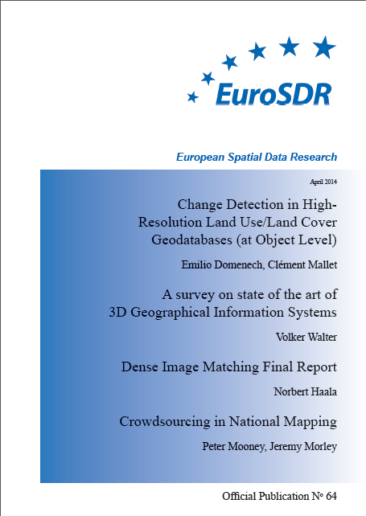
Activities of EuroSDR
Research projects
Project on the interoperability experiment on defining
Validation Data Quality Requirements of CityGML data
Project Benchmarking on Terrestrial Laser Scanning
for Forestry Applications
Project Dense Image Matching
EuroSDR archiving working group
Publications
Courses (EduServ)
RPAS in land survey – theory and practice
Change detection in High Resolution Land Use/Cover Geodatabases
Mapping using high-resolution satellite imagery

Slide 5
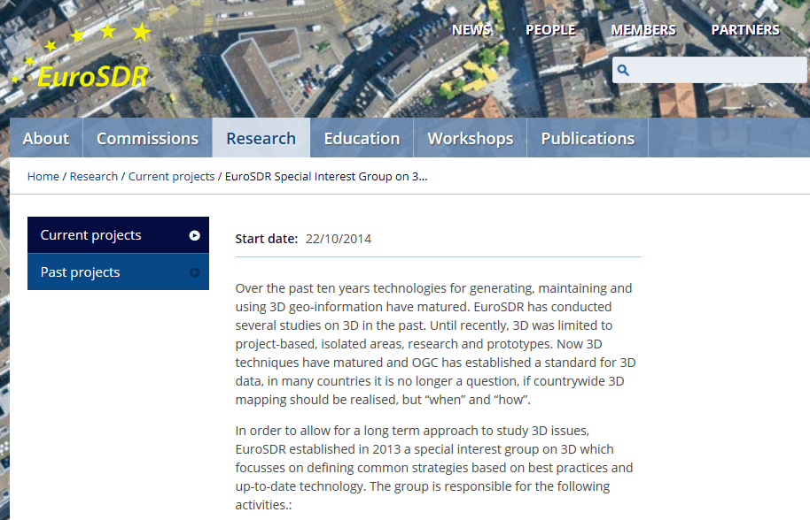
Special Interest Group on 3D

Slide 6
Special Interest Group on 3D
Objective: identify common research topics to pursue as integrated EuroSDR research programme
Participants:
Switzerland, OSUK, OSI, Kadaster NL, LM Sweden, IGN Belgium, BVV Bavaria, Finland, Poland, IGN France
Collaboration with industry and academia is important
Specific points of interest
  countrywide (from projects to production)
  continuous incremental updating
  ensuring consistency 2D and 3D
Activities
  Working Meetings (3-4 per year)
  Workshop series
  Projects (e.g. economic benefits of 3D)
  Monitoring state of the art and remaining issues
  Development of common vocabulary on 3D topographic mapping

Slide 7
Trends in 3D
Mapping increasingly done in 3D (landscape/terrain modelling)
use of point clouds, DTM, DEM
From small/medium scale to large scale
Towards countrywide coverage
Increased use in urban areas (city modelling, planning)
High resolution/high density acquisition methods
(imagery (aerial, terrestrial), laser scanning, Lidar)
Modelling of buildings
(bringing together construction (BIM) and mapping (CityGML))

Slide 8
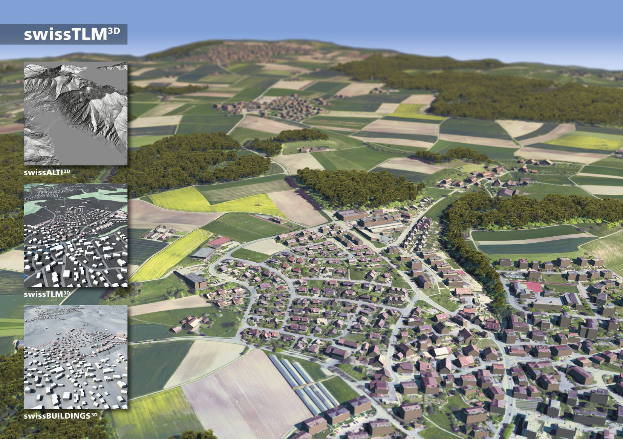

Slide 9
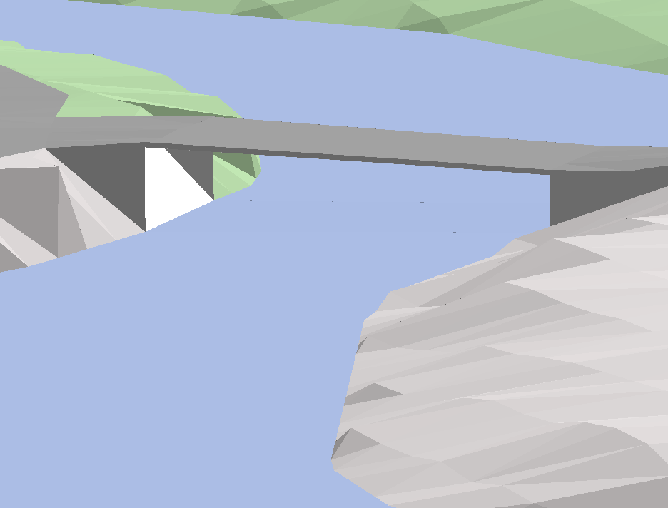
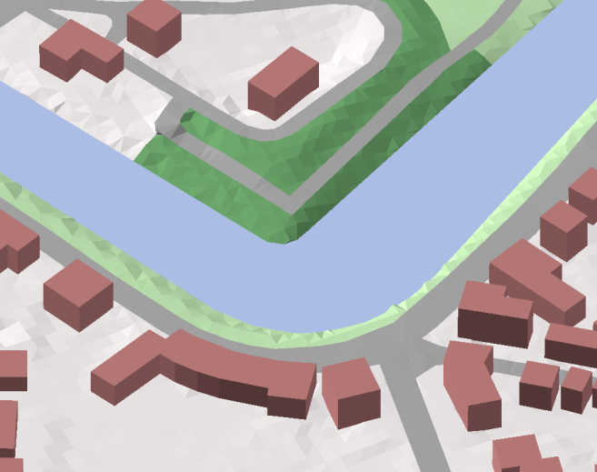
3D TOP10NL (The Netherlands)

Slide 10
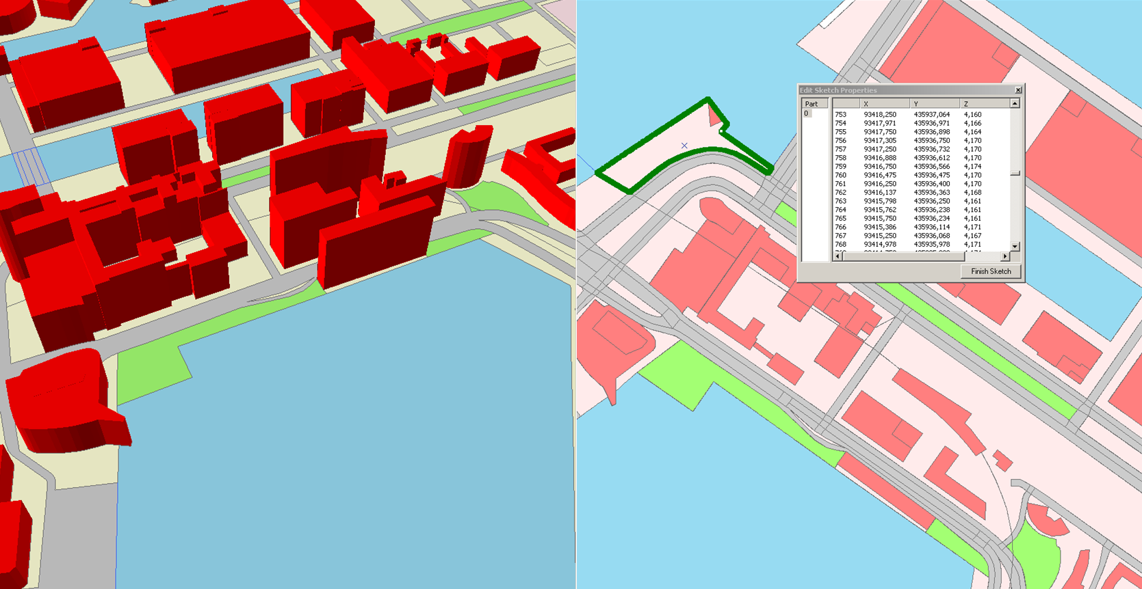
Large scale 3D topographic mapping

Slide 11
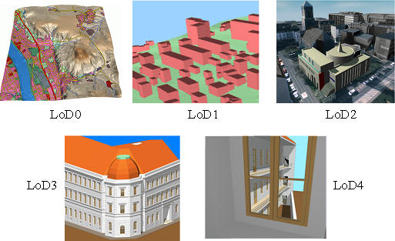
Level of Detail of Buildings

Slide 12
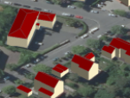
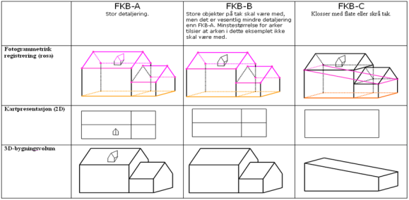
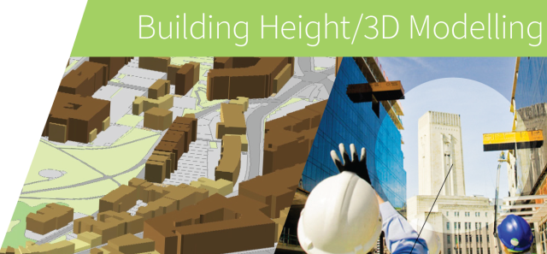
Buildings; state of play
Bavaria (BVV)
8.1 million buildings: LOD1 (now) and LOD2 (2016)
Outline of building in relation with cadastral map
Sweden (Lantmäteriet)
8 million houses (roof edges in 2,5D)
UK (Ordnance Survey)
OS MasterMap Building Height Attribute
Coverage more 11000 and 40000 sq.km in urban and rural areas respectively

Slide 13
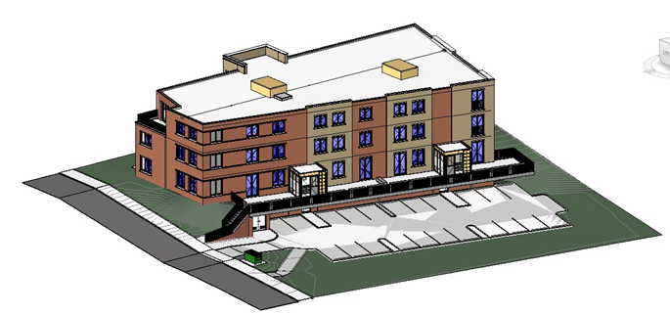
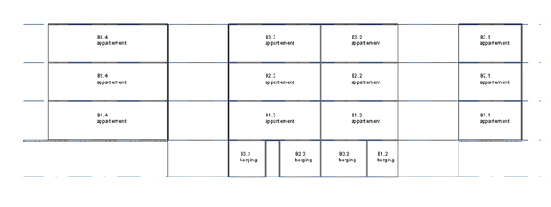
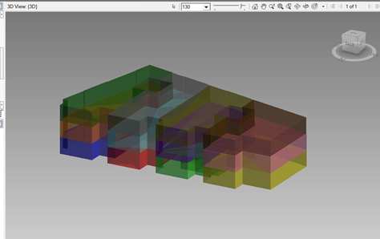
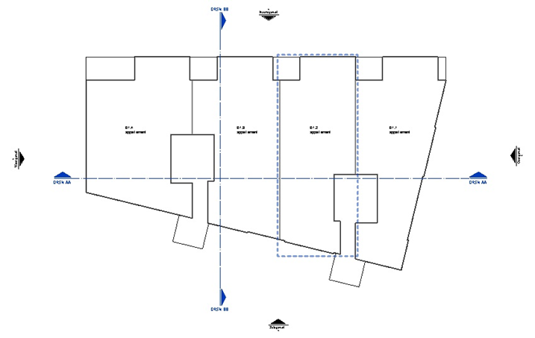
From design (BIM) to 3D cadastral information

Slide 14
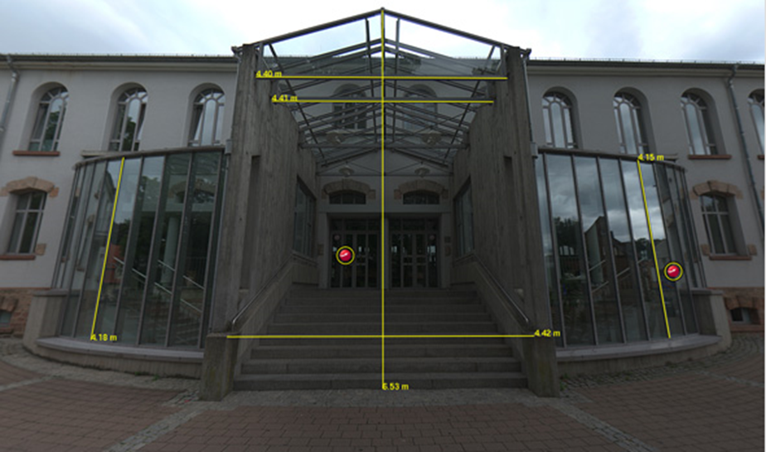
Measuring in Terrestrial Imagery

Slide 15
Research issues within the 3D-SIG
3D object reconstruction
3D standards and data modelling
Maintenance, storage and update
3D dissemination and portrayal
Integration, fusion and consistency (e.g. 2D and 3D)
Users and customers (use cases)

Slide 16
Concluding remarks
3D is maturing in the large-scale domain
becomes interesting at the parcel/building level
Many NMCA’s are working on countrywide coverage
either in development or production phase
mapping and cadastral applications meet
Need for a reliable update process
(currency, relation to other datasets)
Collaborate with other 3D data collectors/industries
new/additional technologies
cradle to cradle (from design to mapping)

